Slide 1
We are going to the National Museum of Scotland

Slide 2

We are visiting the National Museum of Scotland on
We will be leaving school at

Slide 3
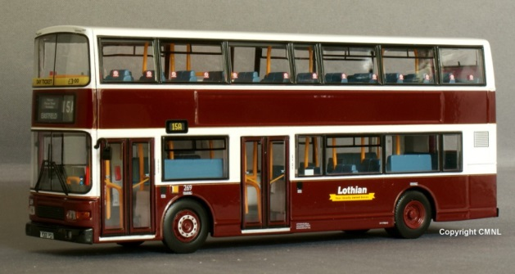
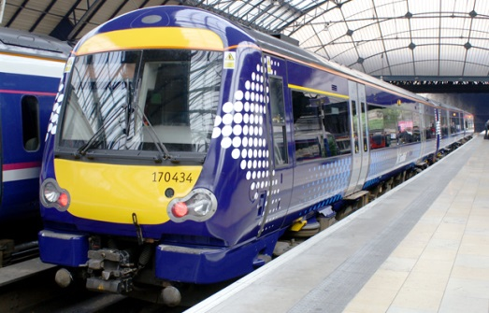
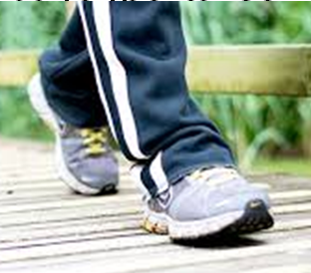
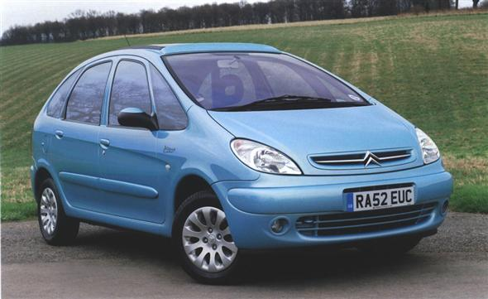
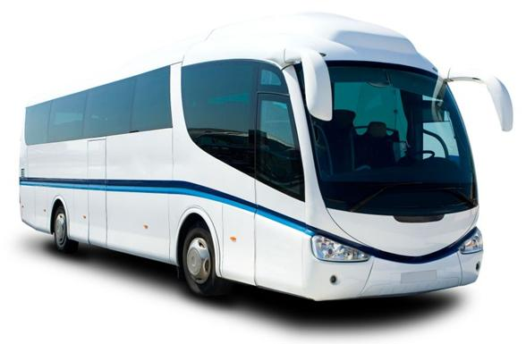
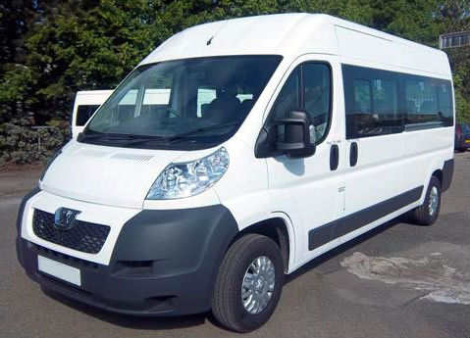
We are travelling to the museum by…
Bus
Train
Walking
Car
Coach
Minibus

Slide 4
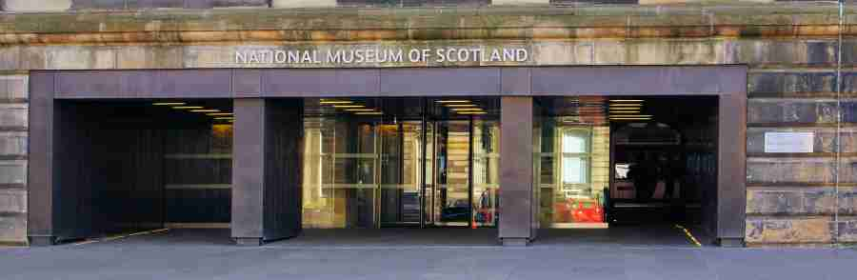
Museum Entrance
We will go into the museum through this entrance.
We can go through the revolving doors or push a button to go in.

Slide 5
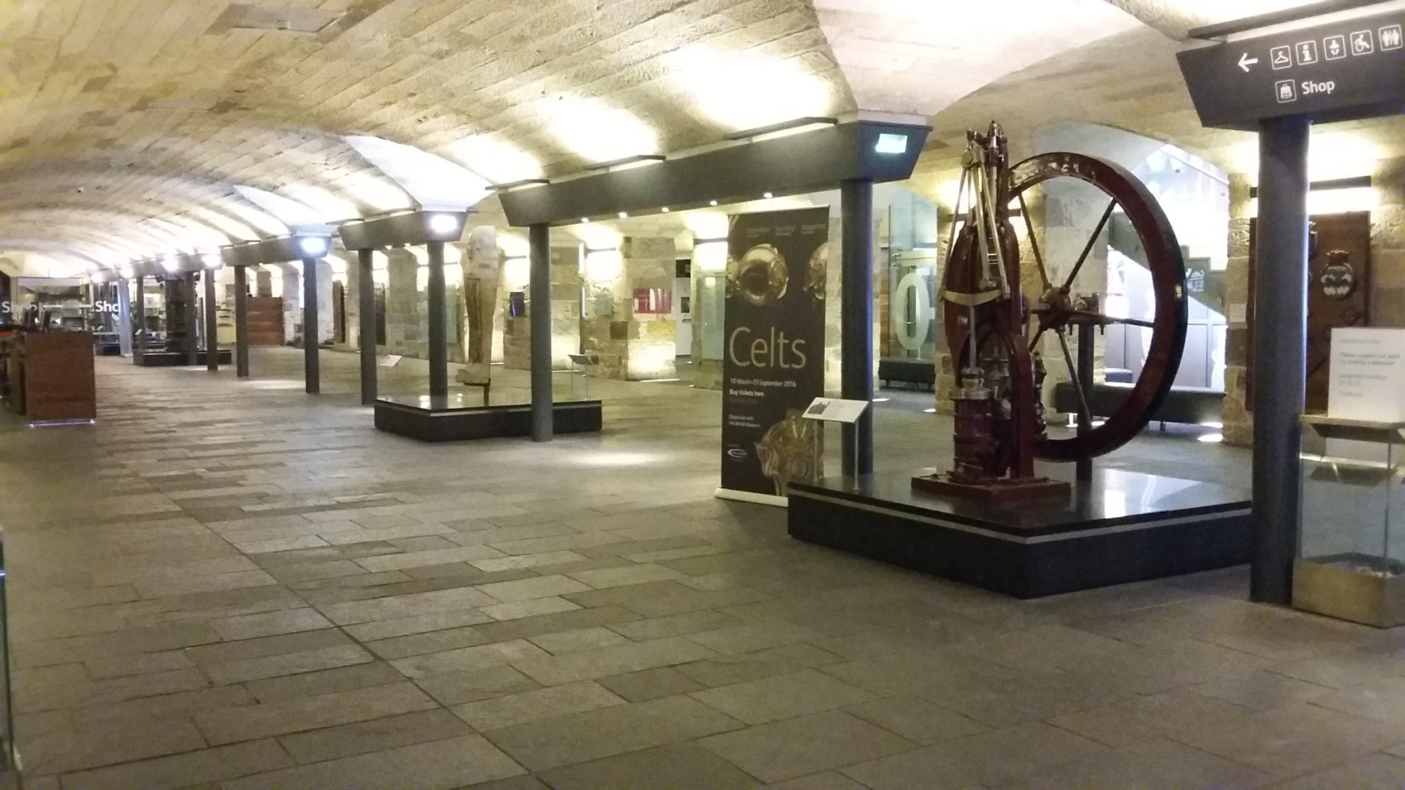
This is the museum Entrance Hall
It might be busy.

Slide 6
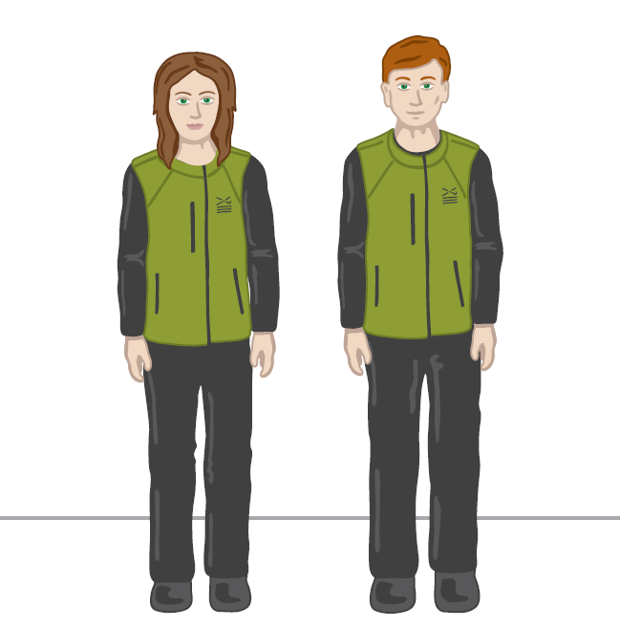
We might meet an Enabler. They wear uniforms that look like this and might be wearing face masks

Slide 7
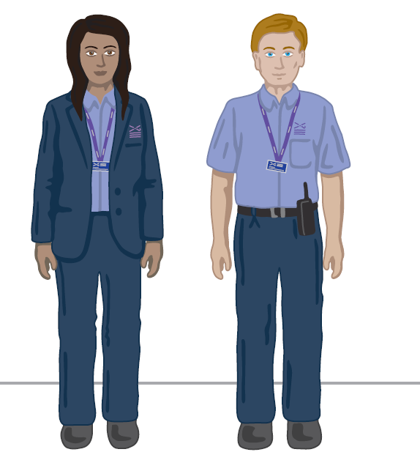
We might meet a Visitor Experience Assistant. They wear uniforms that look like this and might be wearing face masks.

Slide 8
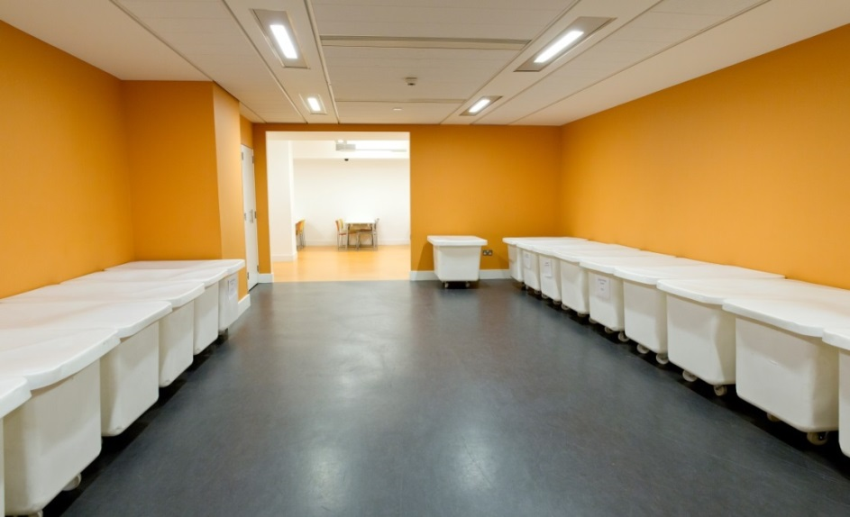


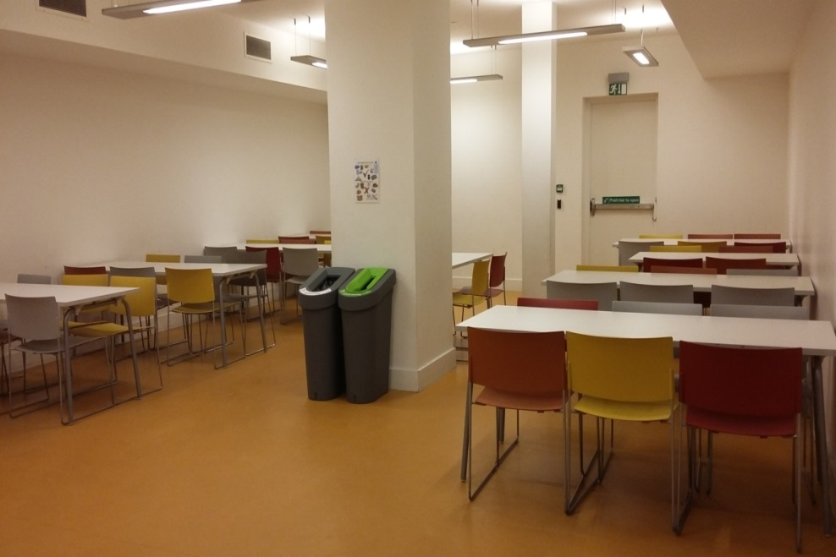
We will go into the Museum’s group space.
We can leave our bags and coats in the white tubs in the lunch room while we explore.
The white tub will have a number on it. Our school name will be on a sign which tells us which number.
Sometimes this room can be busy and noisy with other school pupils in.

Slide 9
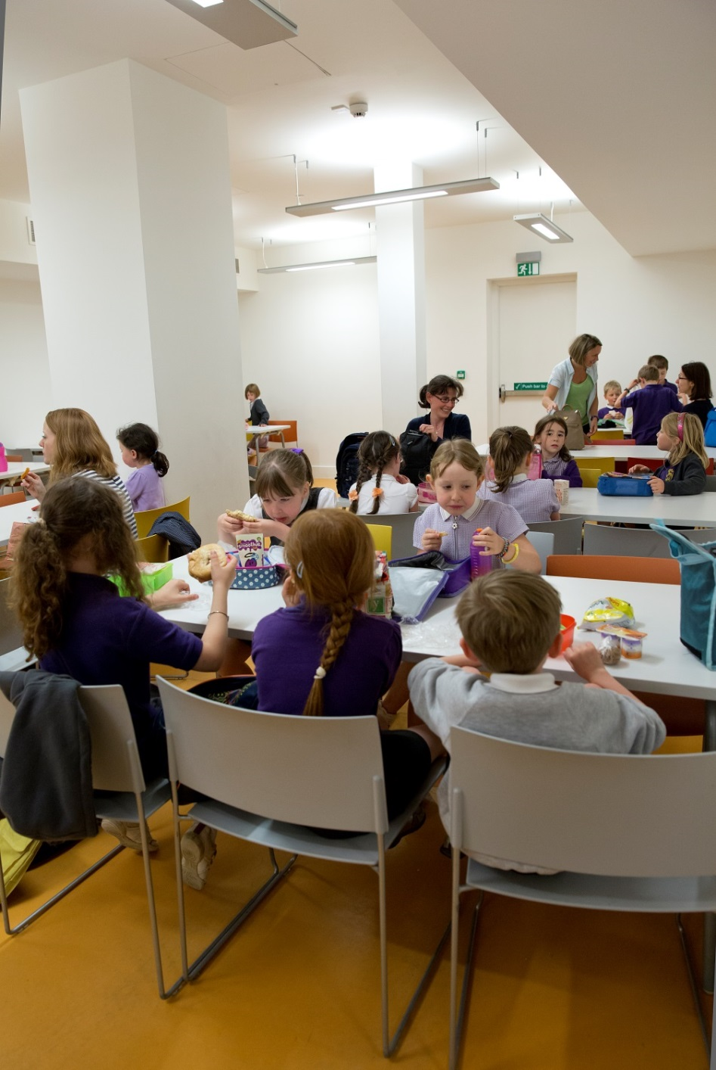

We can eat our snack and packed lunch here.
We will have our lunch at ………

Slide 10
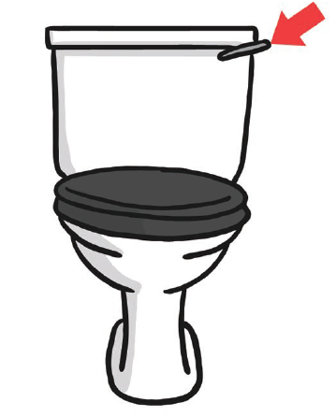
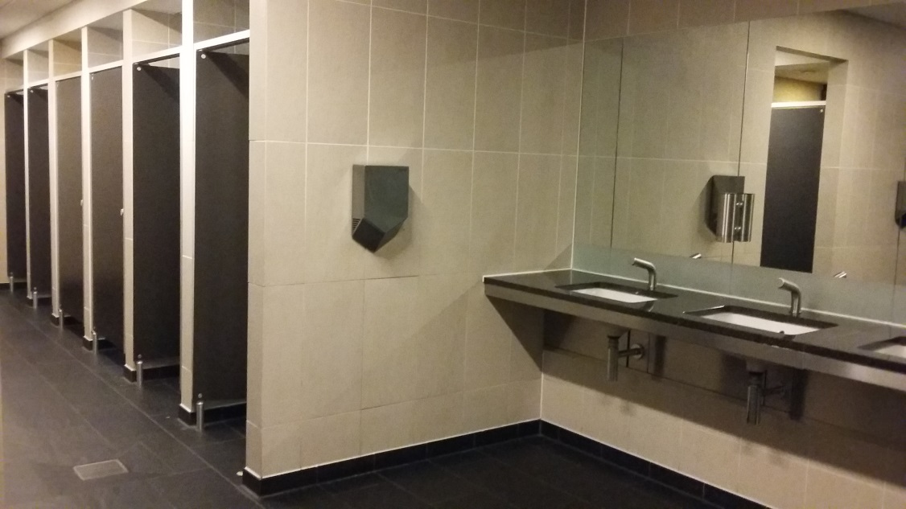
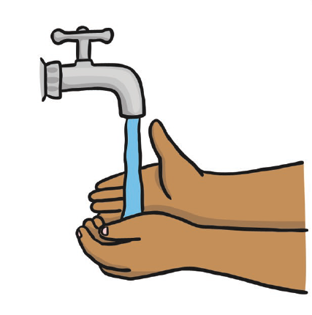
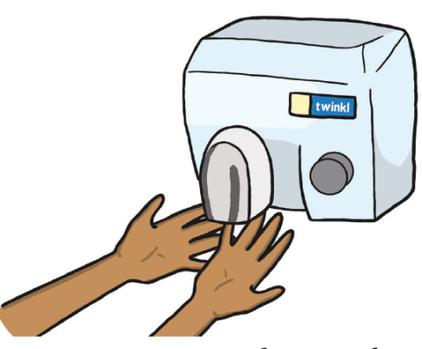
These are toilets on Level 0 in the Entrance Hall.
The hand dryers are very loud.

Slide 11
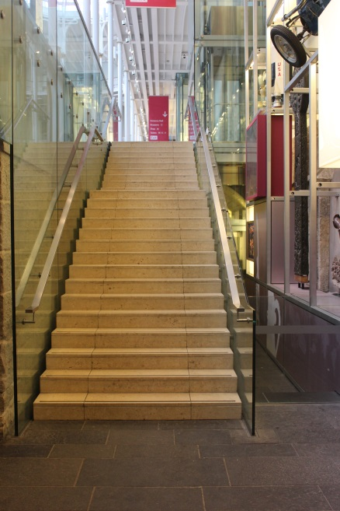
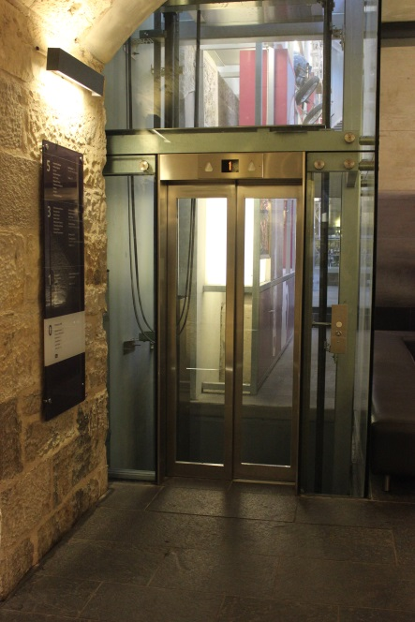
From the Entrance Hall we will go up the stairs to get to the Grand Gallery. We can also take the lift.
Stairs
Lift

Slide 12
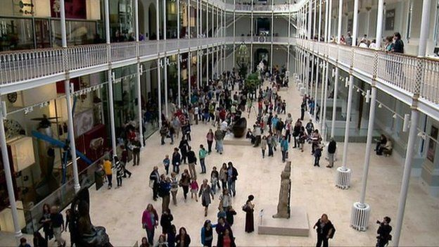
We will move around the museum in a group. It might be busy and noisy with people talking.

Slide 13
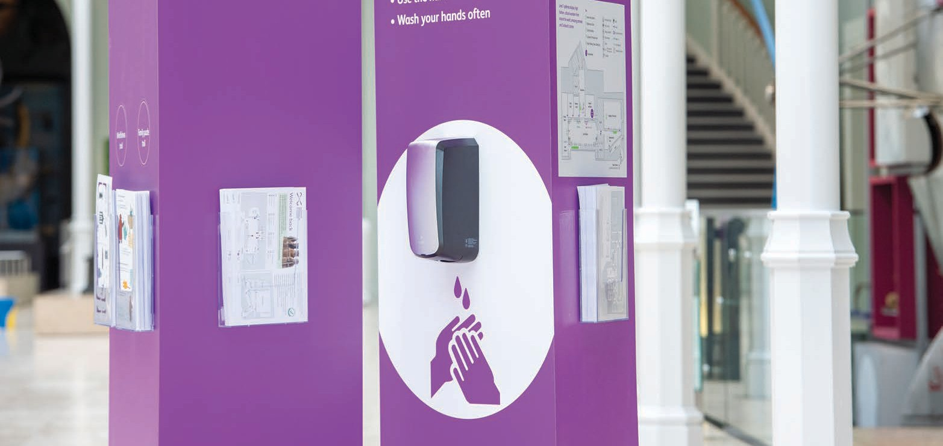
There are hand sanitising stations if I want to clean my hands.
I will find these stations throughout the museum.

Slide 14
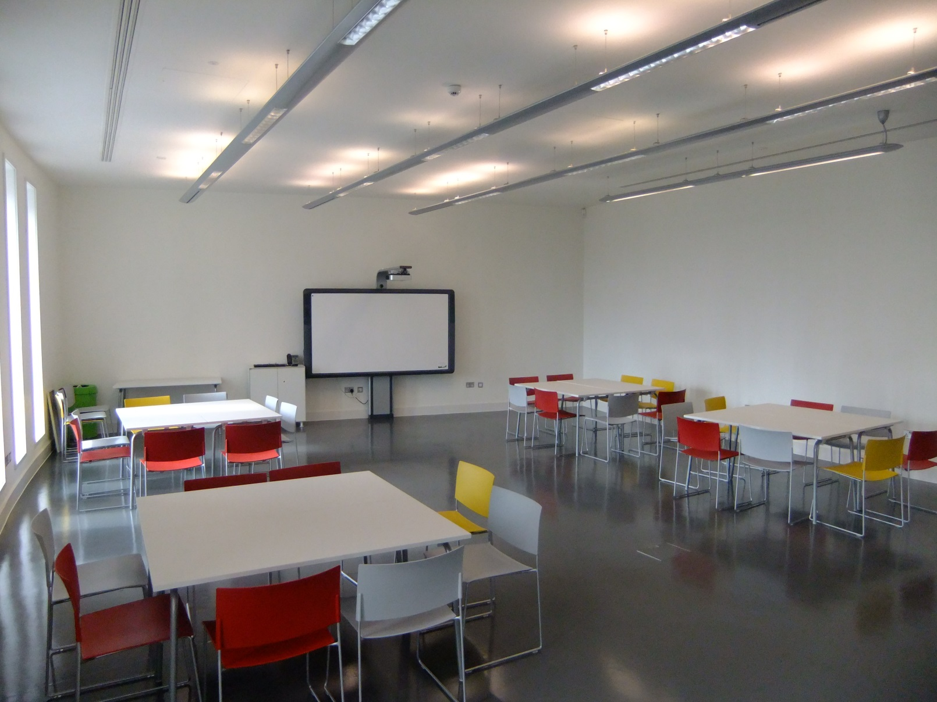
We might visit the learning studios on Level 4. They look like a classroom with tables and chairs.

Slide 15
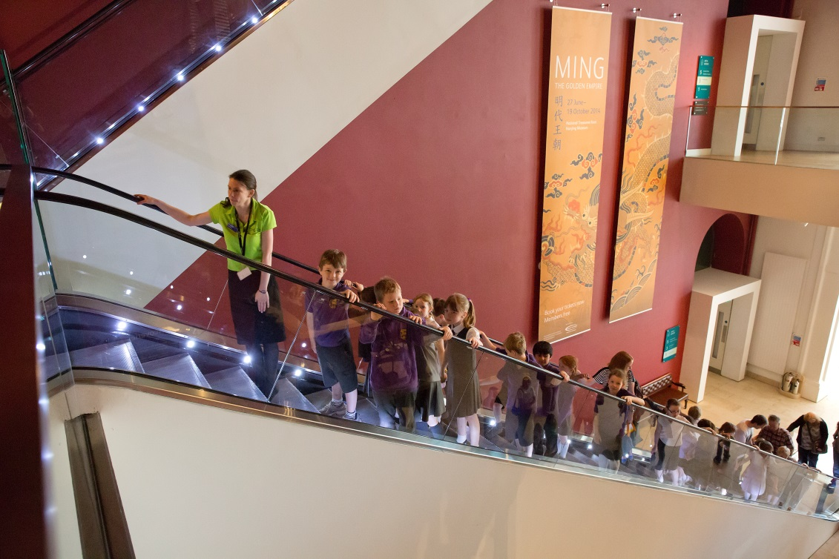
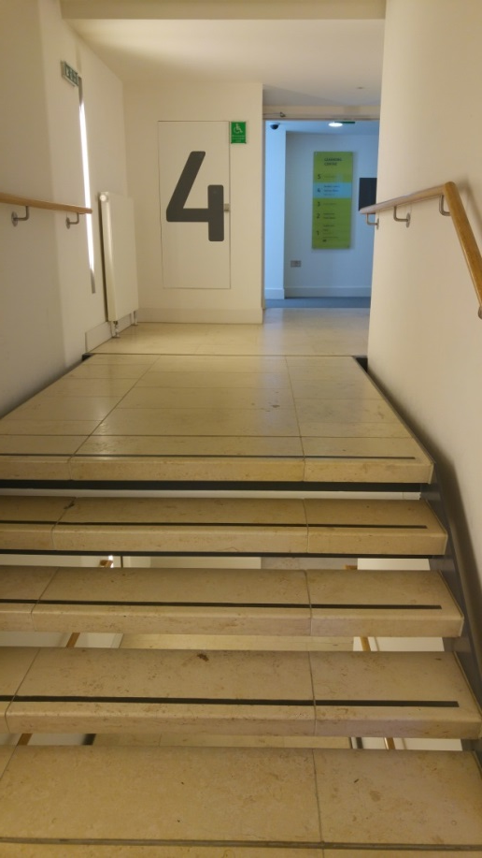
To get to the Learning Centre we can use the escalator or the stairs.
Escalator
Stairs

Slide 16
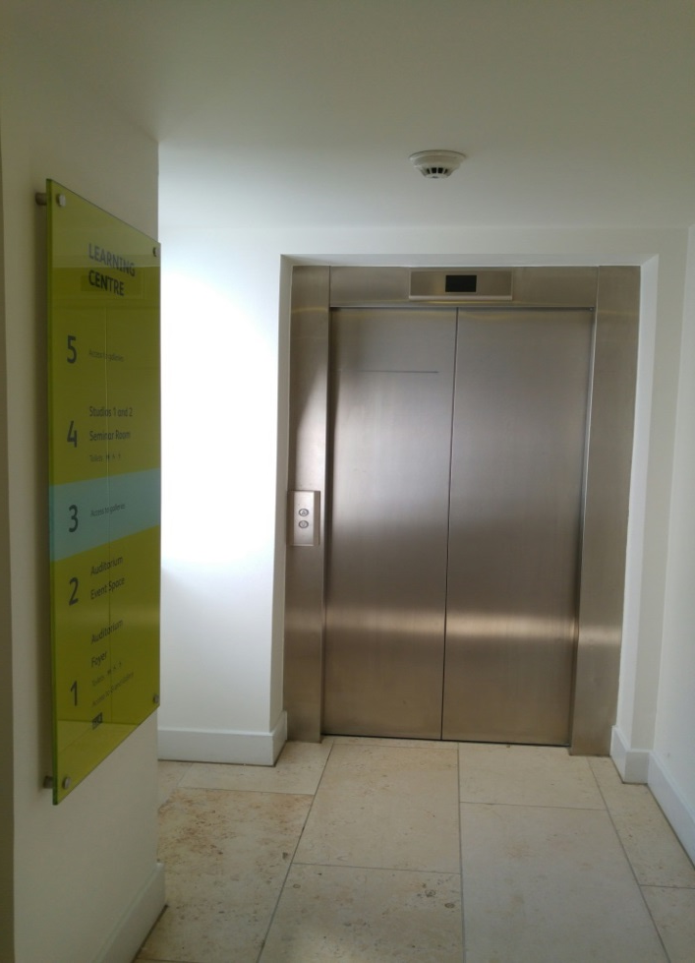
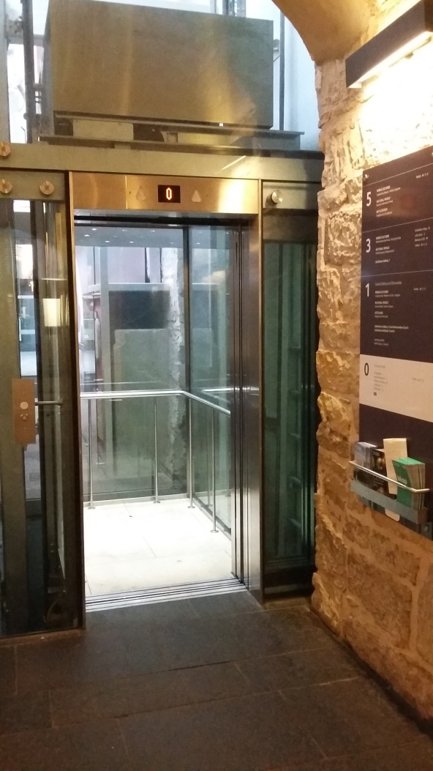
The museum also has lifts.

Slide 17

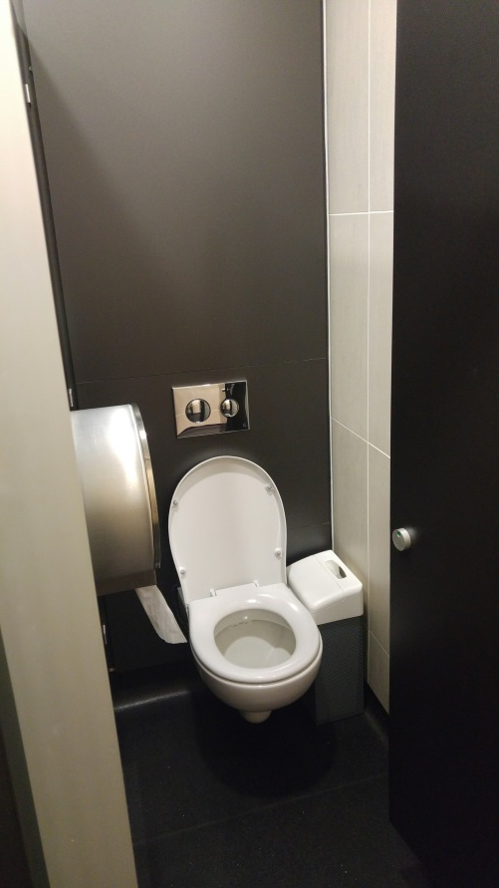
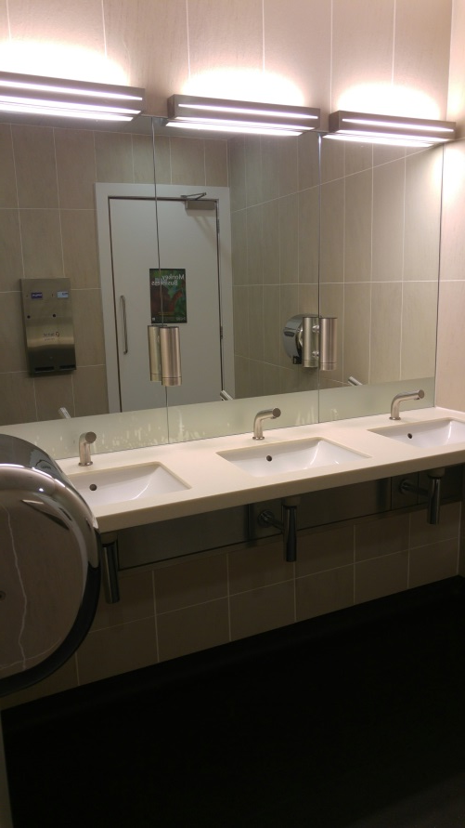
There are toilets near the Learning studios.
The hand dryers are very loud.

Slide 18








The museum has lots of different things in it. It has objects about…
Space
Scotland
Animals
Fashion
Art and design
Science and technology
And things from all across the world

Slide 19
While we are at the museum we will…

Slide 20
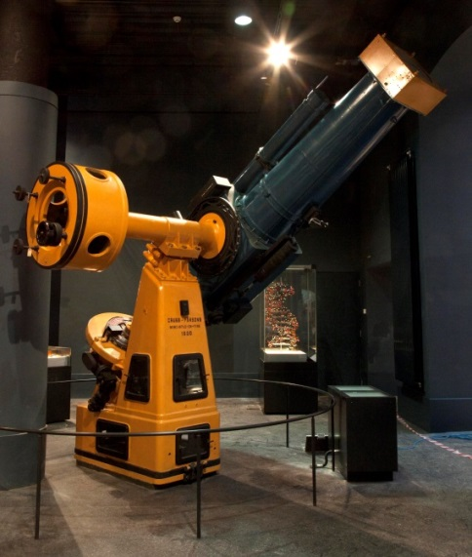
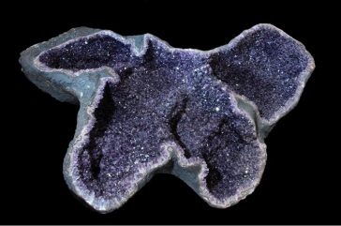
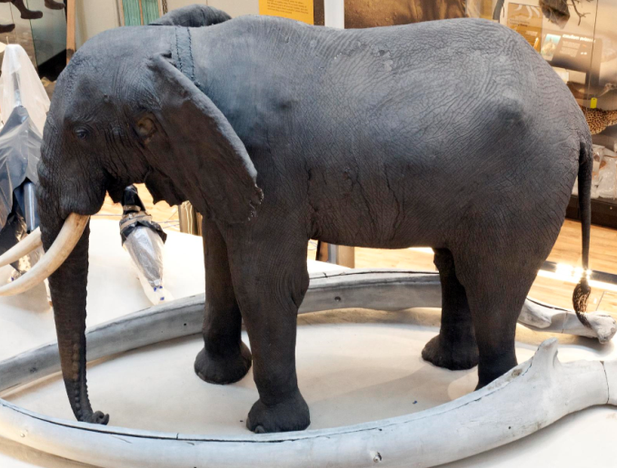
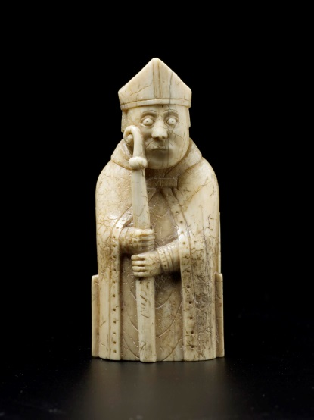
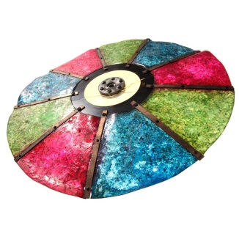
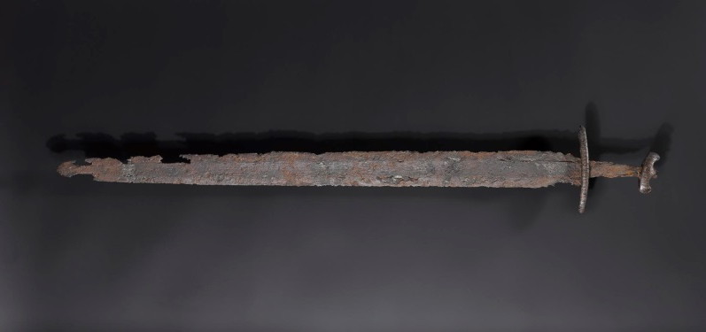
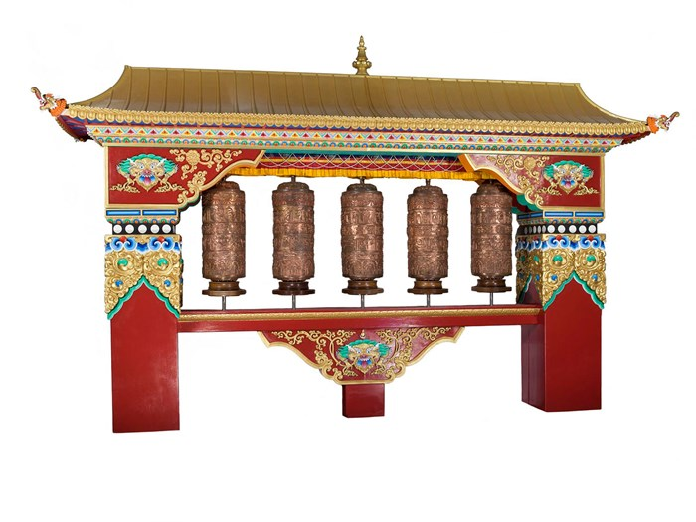
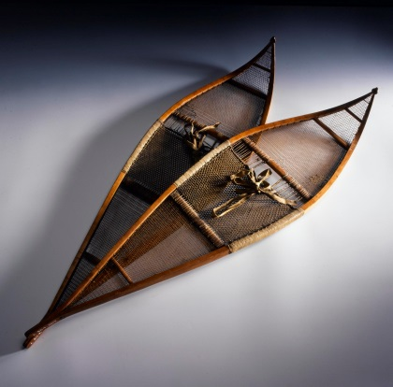
See lots of interesting things.
Some things we will have seen before and some might be new.

Slide 21
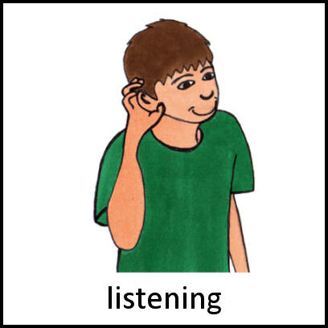

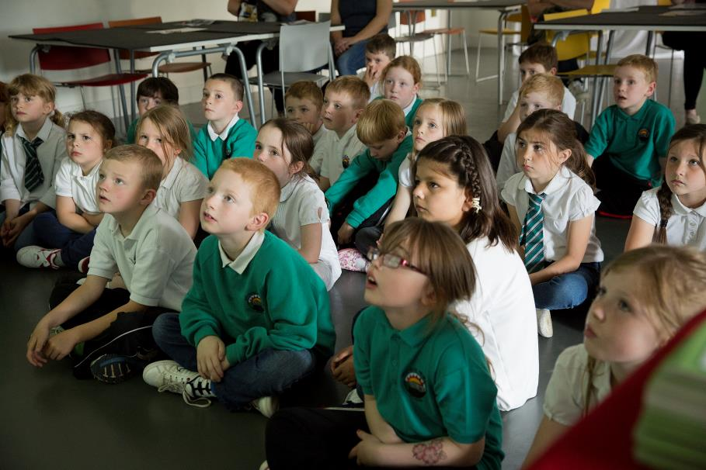
Listen and learn

Slide 22
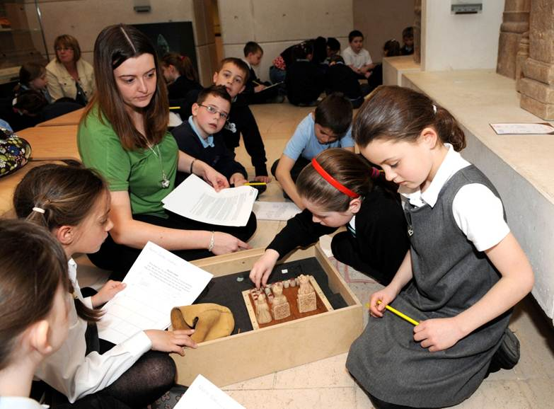
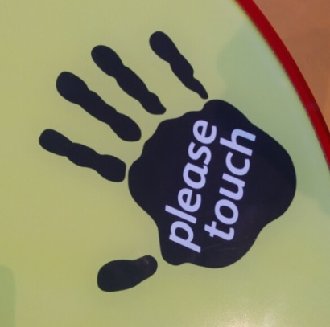
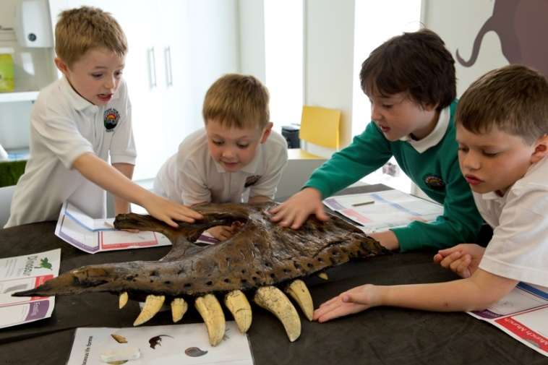
We might get to touch some objects
If we can see the ‘please touch’ sign on an object then we can touch it! If not, don’t touch the object.
If we are in a workshop, the Enabler or our Teacher will tell us what objects we are allowed to touch.

Slide 23
Today we are going to learn about…

Slide 24
We might see…
Add in what you are planning on looking at e.g.
  Animals
  Space
  Vikings etc.
  If you want to add in pictures of some of the museums’ objects you can search the collections here: http://www.nms.ac.uk/explore/search-our-collections/
  This could be a fun pre-visit planning activity.

Slide 25
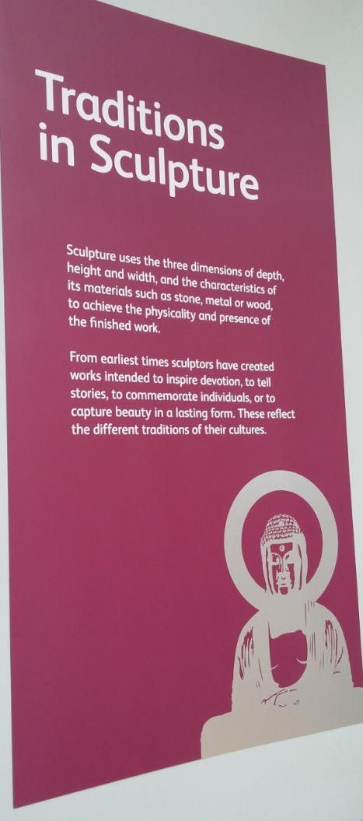
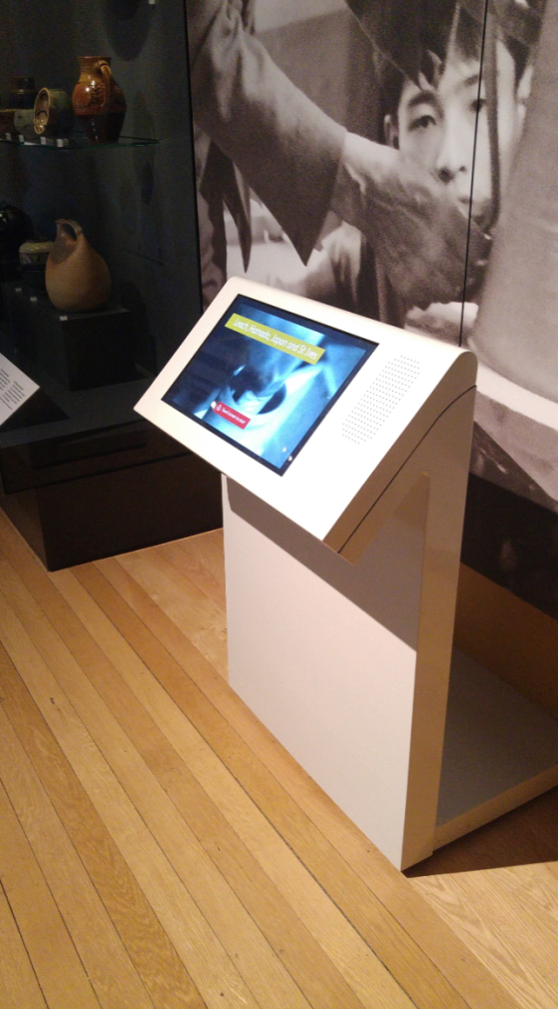
We can find out more about them.
Panels on the wall and labels in the cases will tell us about the things we see.
There might be touchscreen computers where we can find out more.

Slide 26
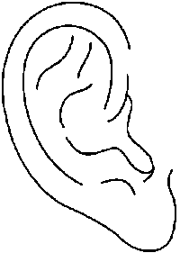
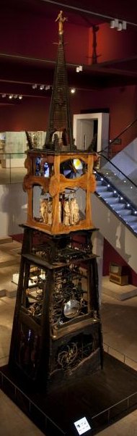
We might hear…
Other people talking, shouting and laughing
Music from the Millennium clock or from musical instruments
Beeps, whirring and clanking from some of the machines

Slide 27
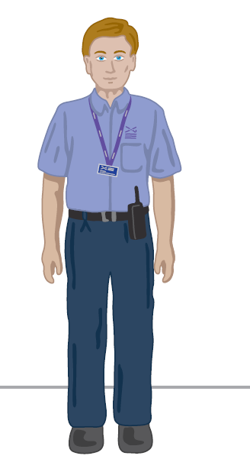
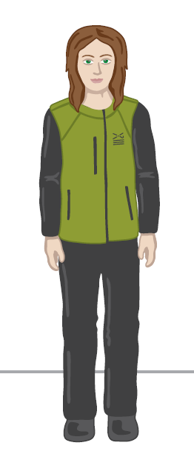
If we need a break or want to ask a question about the museum we can talk to someone who works at the museum. They wear uniforms that look like this:
Enabler
Visitor Experience Assistant

Slide 28
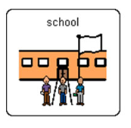
We will leave the museum at
And go back to school.

